Slide 1
Javascript Intro3
R.Rizal Yuniar.S

Slide 2
Objective
Asynchronous
Promise
Async Await
Try catch

Slide 3
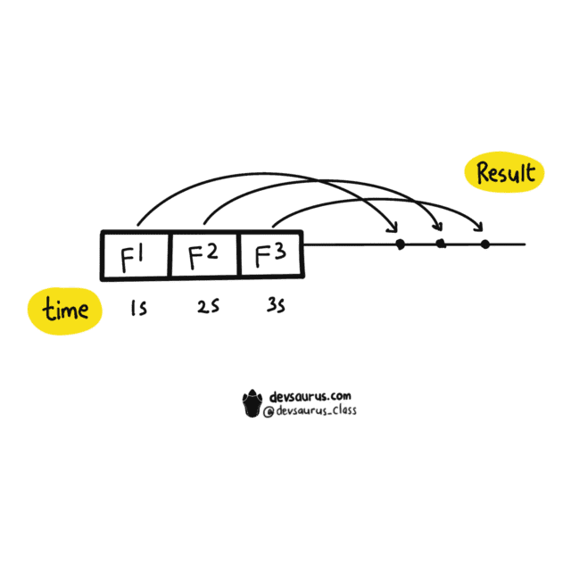
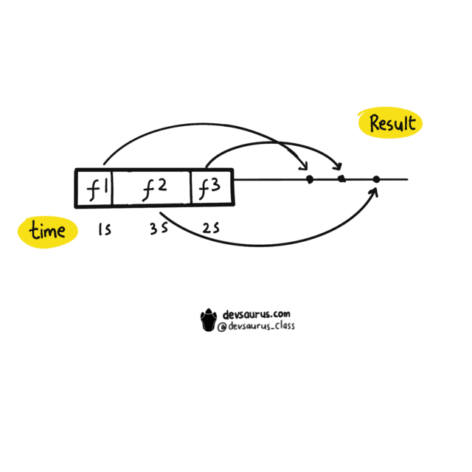
Synchronous dan Asynchronous
JavaScript termasuk Single Threaded Programming Language.
Yaitu JavaScript hanya bisa melakukan satu operasi di satu waktu, sehingga code JavaScript dieksekusi secara berurutan dari atas ke bawah layaknya sebuah antrian atau biasa disebut synchronous.
Namun hal ini bisa menjadi masalah jika terdapat code yang eksekusinya membutuhkan waktu yang lama.
Pada konsep asynchronous, code akan dieksekusi tanpa menunggu eksekusi code lain selesai sehingga seakan-akan dieksekusi secara bersamaan.

Slide 4
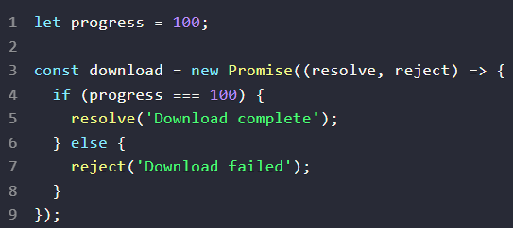
Promise
Promise bisa dikatakan sebagai object yang menyimpan hasil dari sebuah operasi asynchronous baik itu hasil yang diinginkan (resolved value) atau alasan kenapa operasi itu gagal (failure reason).
Sebuah Promise berada di salah satu diantara 3 kondisi:
pending, operasi sedang berlangsung
fulfilled, operasi selesai dan berhasil
rejected, operasi selesai namun gagal
Notes:
Create an outline to get ready:
Introduce the era (Use a mix of media and text)
Organize your artifacts to outline what life was like during the era you are presenting
Think about using a storyboard to outline your images and ideas
Make sure you prepare a clear and well rounded presentation of all aspects of the era (People, jobs, food, transportation, etc. What else should you include so the audience feels like they have visited your era?)

Slide 5
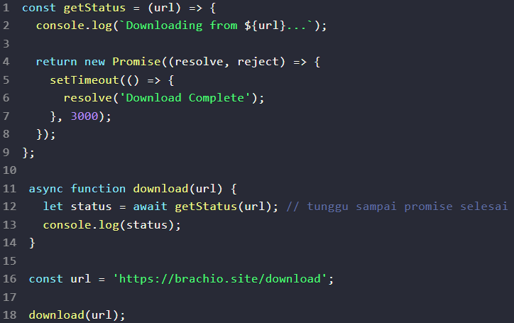
Async Await
Async/Await diperkenalkan di ES8 / ES2017 untuk menghandle operasi asynchronous dengan syntax yang lebih mirip dengan synchronous.
Async/Await merupakan sebuah syntax khusus yang digunakan untuk menangani Promise agar penulisan code lebih efisien dan rapih.

Slide 6
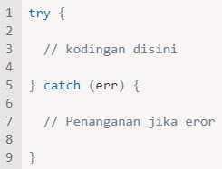
try catch
Dari namanya sendiri, Try bisa di katakan untuk mencoba dan catch adalah untuk menangkap.
Mencoba apa ? Mencoba untuk menjalankan sebuah blok kode.
Menangkap apa ? Menangkap error misalnya error tersebut terjadi.

Slide 7


TERIMA KASIH

Slide 8
Collage of the era
Create a visual representation of the era, including pictures of:

Slide 9

Famous person
Famous person from the era:
Add an image of a famous person from the era and then explain his/her significance.
You could also use a slide like this to capture an important event during the era.

Slide 10
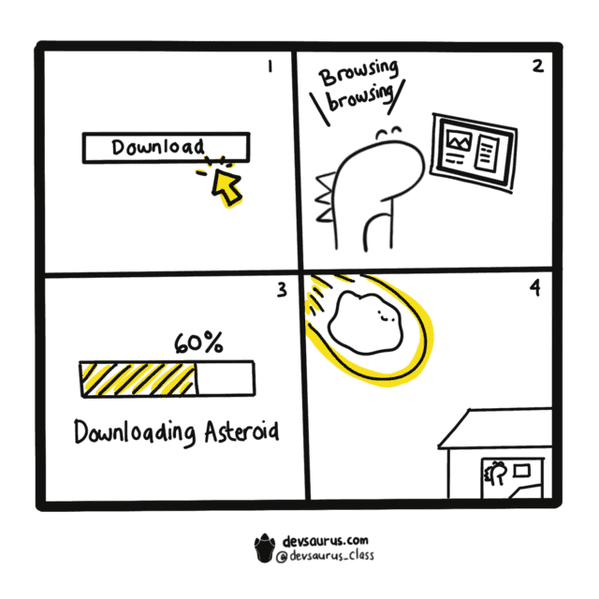
Asynchronous dan Synchronous

Slide 11



Introduce the era
Use this type of slide for visual impact.
You can use images or text here.
Limit your text to key concepts and words so you can explain them during your presentation.

Slide 12





Collage 2 of the era
Create a visual representation of the era, including pictures of:

Slide 13
Compare and contrast something from the era
Use this for the title
Use this for the title
You might use a map of the area during different time periods within the era – was there a lot of growth? What did it look like before and after? Or
Consider comparing and contrasting the beginning of the era to the end of the era.
Add an image or text here to compare/contrast.

Slide 14
Letter from the generation
Things to reflect on when writing the letter:
How would they like to be remembered?
What message would they want to share?
Would they give future generations any advice? If so, what would it be?
What do you think the people who lived in that era would say to you about their lives and experiences?
Include a message from the generation to future generations who find the time capsule.
Signed by Gen XYZ

Slide 15
Customize this Template
Template Editing Instructions and Feedback

